Slide 1


An Intelligent Application for Improving English Proficiency Using Machine Learning
This innovative application leverages the power of machine learning to help users enhance their English proficiency through personalized, interactive sessions. By combining advanced algorithms and a user-friendly interface, the app provides a seamless and effective language learning experience.
by Abhijeet Shinde

Slide 2
Algorithms for Optimal Performance
Decision Tree
Linear Regression
Gradient Boost
The decision tree algorithm achieved the highest R2 score, making it the most effective model for predicting language improvement.
Linear regression provided valuable insights into the relationship between learning factors and proficiency levels.
The gradient boost method also demonstrated strong performance, adding another layer of accuracy to the language predictions.

Slide 3

Interactive Speech-to-Speech Conversations
Conversational Practice
Personalized Feedback
Users can engage in speech-to-speech interactions, allowing them to practice their English skills in a dynamic, real-time setting.
The app provides personalized feedback and suggestions to help users improve their pronunciation, grammar, and overall fluency.
Adaptive Learning
Immersive Experience
The application adapts to the user's progress, adjusting the difficulty and focusing on areas that need the most attention.
The speech-to-speech feature creates an immersive learning environment, allowing users to feel more engaged and motivated.

Slide 4

Proficiency Assessment and Personalized Goals
1
Initial Assessment
The app calculates the user's initial English proficiency level through a comprehensive assessment at the start of the program.
2
Personalized Goals
Based on the initial assessment, the app provides a personalized learning plan, including the number of days and minutes per day required to reach a proficiency level of 90% or higher.
3
Ongoing Progress Tracking
Throughout the learning journey, the app continuously monitors the user's progress and adjusts the learning plan accordingly to ensure optimal results.

Slide 5





Engaging Learning Environment
Gamification
Personalized Scheduling
Social Connectivity
Achievements
Incorporating game-like elements, such as points, badges, and leaderboards, to foster a fun and motivating learning experience.
Enabling users to connect with other learners, share progress, and collaborate on language-learning activities.
Celebrating user milestones and successes to foster a sense of accomplishment and boost motivation.
Allowing users to create customized schedules and reminders to ensure consistent practice and progress tracking.

Slide 6
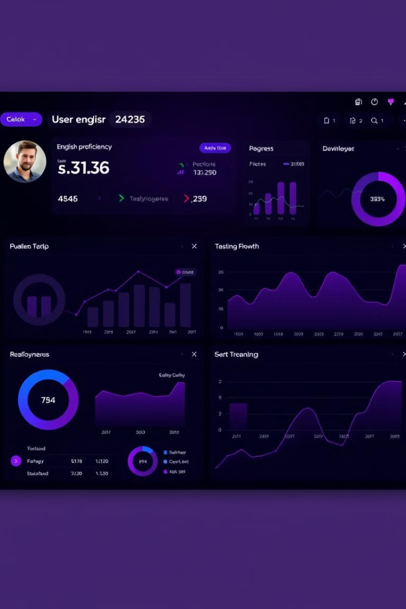
Powerful Reporting and Analytics
1
Comprehensive Reporting
The app provides detailed reports on user progress, including proficiency levels, areas of strength and weakness, and learning trends.
2
Personalized Insights
Advanced analytics help users and instructors identify patterns, obstacles, and opportunities for further improvement.
3
Goal Tracking
Users can monitor their progress against their personalized goals, ensuring they stay on track to reach their desired proficiency level.

Slide 7
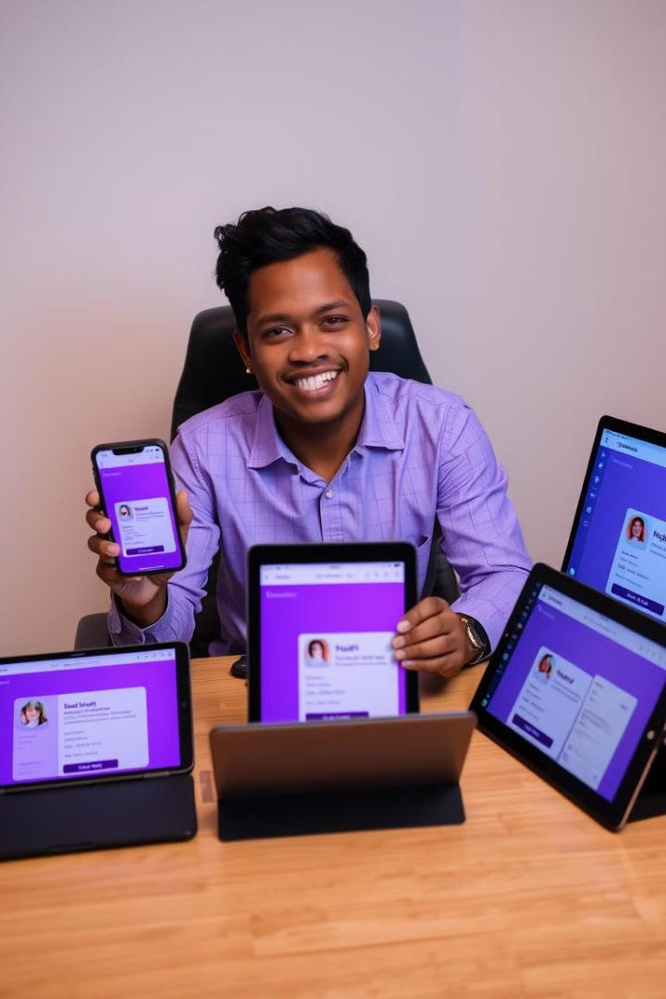



Seamless Integration and Accessibility
Cross-Platform Compatibility
The app is designed to be accessible across multiple devices, including smartphones, tablets, and laptops, allowing users to learn on the go.
Responsive Design
The user interface adapts seamlessly to different screen sizes and resolutions, ensuring a consistent and optimal experience.
Offline Functionality
Users can access and practice their English skills even without an internet connection, making the app highly versatile and convenient.

Slide 8
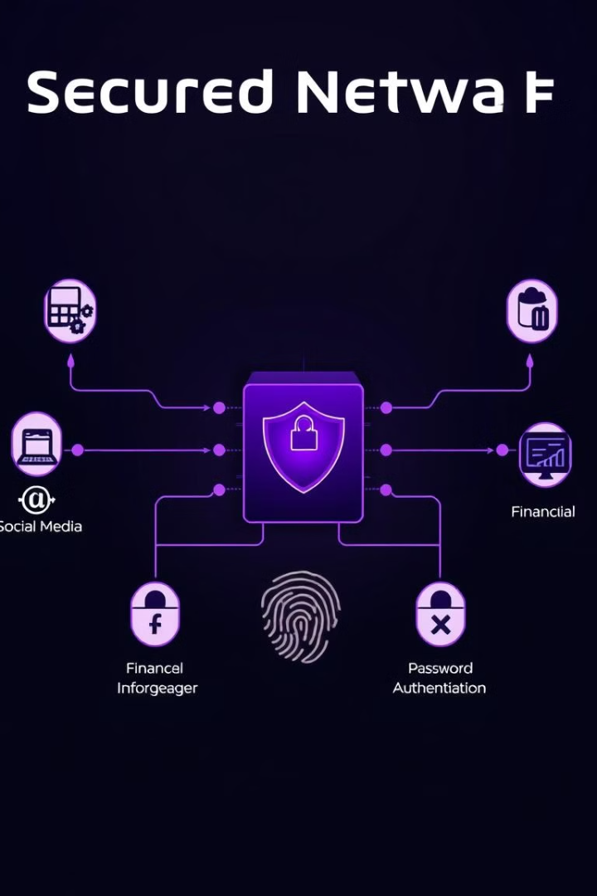
Secure and Reliable Technology
Data Privacy
The app implements robust data privacy and security measures to protect user information and ensure the confidentiality of personal data.
Secure Infrastructure
The underlying technology stack is built on a secure and reliable infrastructure, with advanced encryption, firewalls, and user authentication protocols.
Scalable and Resilient
The app's architecture is designed to handle growing user numbers and traffic, ensuring a seamless and uninterrupted learning experience.

Slide 9
Proven Effectiveness and Customer Satisfaction
Real-World Impact
Customer Satisfaction
Continuous Improvement
The app has demonstrated a proven track record of helping users achieve their English proficiency goals, with numerous success stories and positive user reviews.
Users consistently praise the app's user-friendliness, effectiveness, and the overall positive impact it has had on their language learning journey.
The app's development team is committed to ongoing enhancements, incorporating user feedback and the latest advancements in language learning technology.

